Slide 1
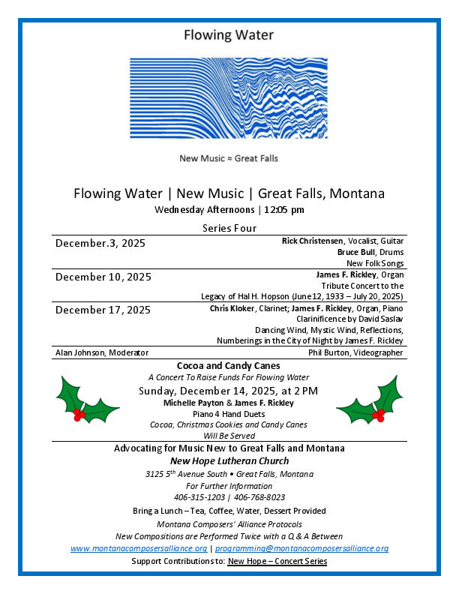

Slide 2

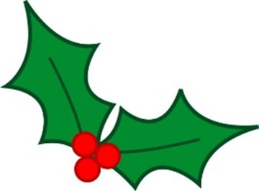
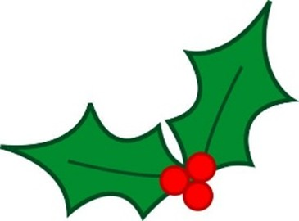
Cocoa and Candy Canes
Michelle Payton
James F. Rickley
Piano 4 Hand Duets

Slide 3
Cocoa and Candy Canes
Joy to the World
Arranged by John Turner

Slide 4
Cocoa and Candy Canes
Hark! The Herald Angels Sing
Arranged by John Turner

Slide 5
Cocoa and Candy Canes
Go Tell It on the Mountain
Arranged by Mark Hayes

Slide 6
Cocoa and Candy Canes
Rise Up, Shepherd and Follow
Arranged by Mark Hayes

Slide 7
Cocoa and Candy Canes
Silent Night
Arranged by John Turner

Slide 8
Cocoa and Candy Canes
Still, Still, Still
Arranged by Mark Hayes

Slide 9
Cocoa and Candy Canes
O Come, All Ye Faithful
Arranged by John Turner

Slide 10
Cocoa and Candy Canes
Intermission
10 Minutes

Slide 11
Cocoa and Candy Canes
Russian Dance (Trepak)
Pyotr Ilyich Tchaikovsky

Slide 12
Cocoa and Candy Canes
Fum, Fum, Fum
Arranged by Mark Hayes

Slide 13
Cocoa and Candy Canes
Jolly Old Saint Nicholas
Arranged by Lani Smith

Slide 14
Cocoa and Candy Canes
God Rest Ye Merry Gentlemen
Arranged by John Turner

Slide 15
Cocoa and Candy Canes
O Tannenbaum – O Christmas Tree
Arranged by John Turner

Slide 16
Cocoa and Candy Canes
Sleigh Ride
Leroy Anderson
Arranged by Michael Edwards

Slide 17
Cocoa and Candy Canes
Winter Wonderland
Felix Bernard

Slide 18
Cocoa and Candy Canes
White Christmas
Irving Berlin
Arranged by Phillip Keveren

Slide 19
Cocoa and Candy Canes
You’re a Mean One, Mr. Grinch
Alfred Hague and Dr. Seuss
Arranged by Sarah Molenaar

Slide 20
Cocoa and Candy Canes
Michelle Payton
James F. Rickley
Piano 4 Hand Duets

