Slide 1
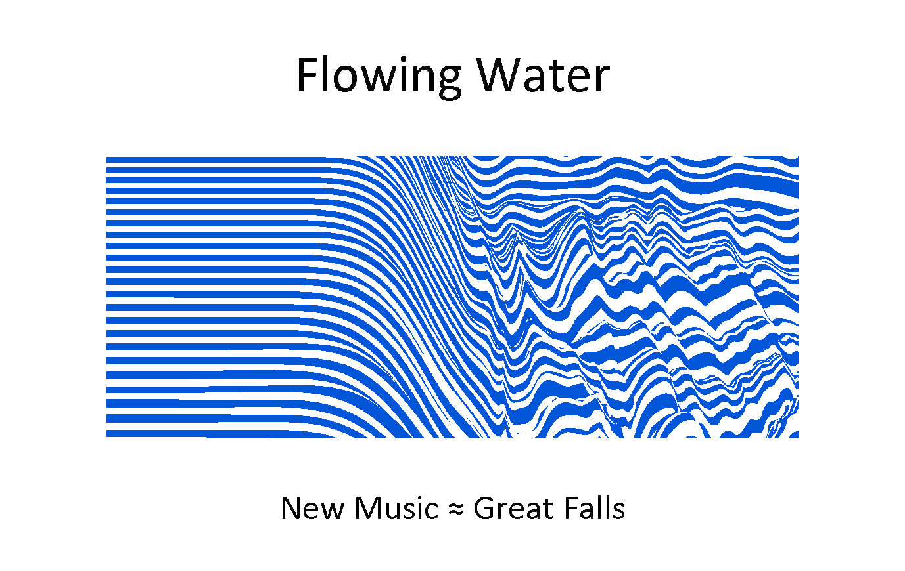
Wednesday 27 November 2024

Slide 2
By Moonlight
By Laura Detrick
Jean Annau, Clarinet
Wendy Weissman, Clarinet

Slide 3
Seven Dances
By James F. Rickley
Jean Annau, Clarinet
Wendy Weissman, Clarinet
Bruce Bull, Percussion
Mark Barry, Percussion
Samarra Nicholson, Dancer

Slide 4
Seven Dances
1
Then Miriam, the prophetess, the sister of Aaron, took a timbrel in her hand; and all the women went out after her with timbrels and dancing.
Exodus 15:20

Slide 5
Seven Dances
2
Praise him with timbrel and dance; praise him with strings and pipe!
Psalm 150:4

Slide 6
Seven Dances
3
And David danced before the Lord with all his might; and David was girded with a linen ephod. So, David and all the house of Israel brought up the ark of the Lord with shouting, and with the sound of the horn.
2 Samuel 6:14-15

Slide 7
Seven Dances
4
Let them praise his name with dancing, making melody to him with timbrel and lyre!
Psalm 149:3

Slide 8
Seven Dances
5
Then shall the maidens rejoice in the dance, and the young men and the old shall be merry. I will turn their mourning into joy, I will comfort them, and give them gladness for sorrow
Jeremiah 31:13

Slide 9
Seven Dances
6
Thou hast turned for me my mourning into dancing; thou hast loosed my sackcloth and girded me with gladness.
Psalm 30:11

Slide 10
Seven Dances
7
The Lord thy God in the midst of thee is mighty, he will save, he will rejoice over thee with joy; he will rest in his love, he will joy over thee with singing.
Zephaniah 3:17

Slide 11
Wednesday 27 November 2024

Slide 12
December 4, 2024
Destin Markland, James F. Rickley, Pianists
17, Reawakening, Progression and Undiminished
by Destin Markland
December 11, 2024
Alan Johnson, Soprano Saxophone
Jake Henneford, Marimba
Phenomenon by James F Rickley
December 18, 2024
Christopher Kloker, Clarinet
Clarinificence by David Saslav
Dancing Wind, Mystic Wind, Numberings in the City of Night by James F. Rickley

